Slide 1
Toronto Crime Analysis – CSI Toronto
Jaehong Kwon
XiongFei (Frank) Shi
Feng Wang
Olive Sun
Neha Nayeem

Slide 2
Descriptions
As a newcomer to Toronto, ….

Slide 3
Data Resources and Considerations
How we find the data.
Limitations and considerations

Slide 4
Our investigation targets
List all our questions here.

Slide 5
Work Flow and Data Cleaning

Slide 6
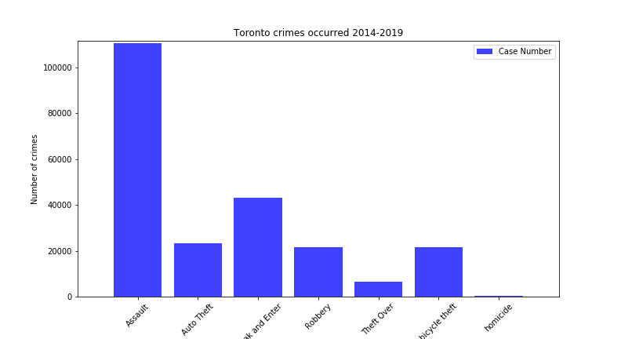
Overall Situations (aka Question 1)

Slide 7
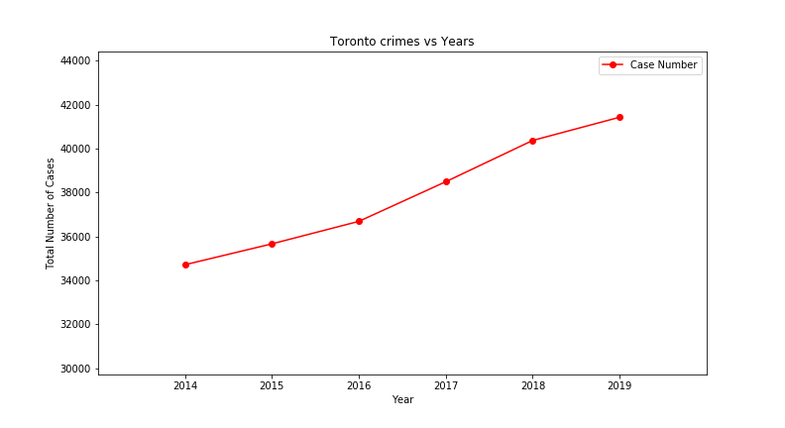
Overall Situations (aka Question 1)

Slide 8
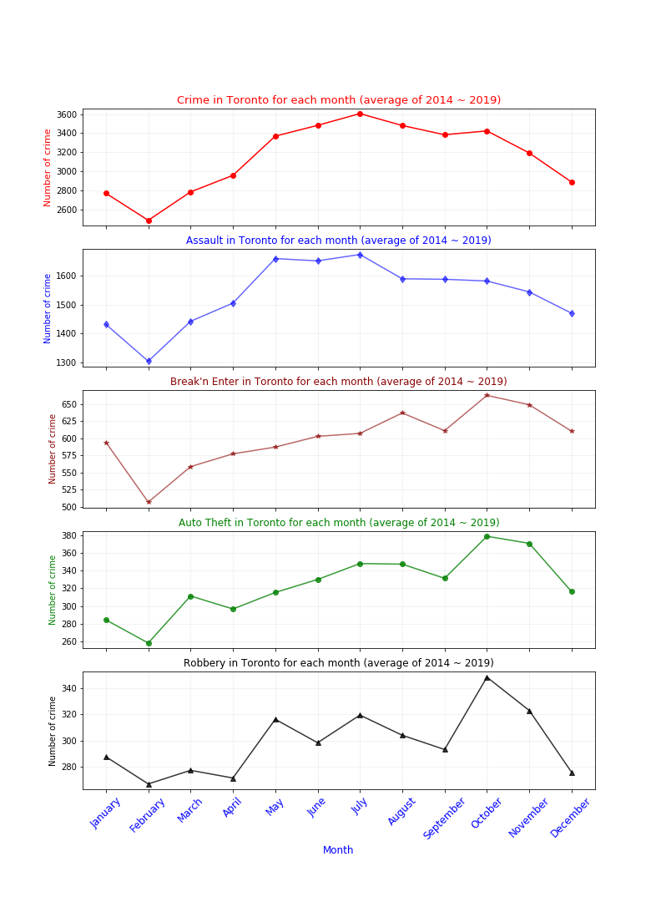
Seasonality and Frequency of Crimes (aka Question 2)

Slide 9
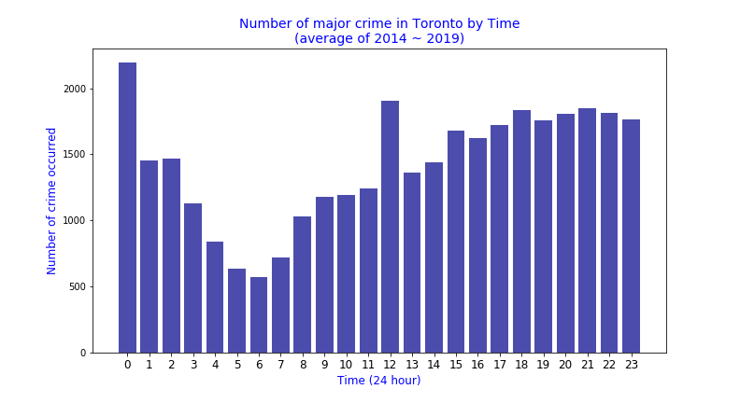
Seasonality and Frequency of Crimes (aka Question 2)

Slide 10
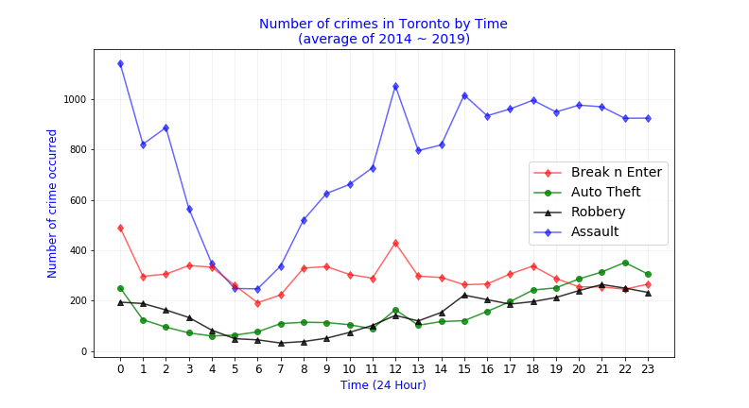
Seasonality and Frequency of Crimes (aka Question 2)

Slide 11
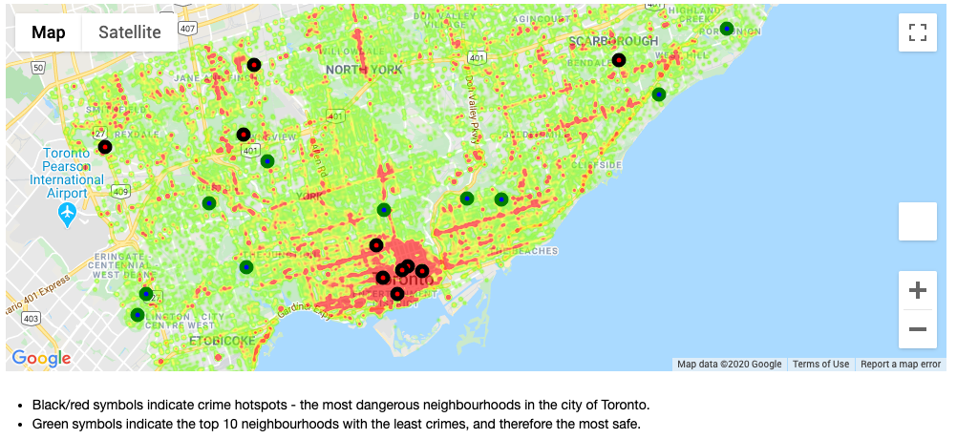
Neighborhood Investigation (aka Question 3)

Slide 12
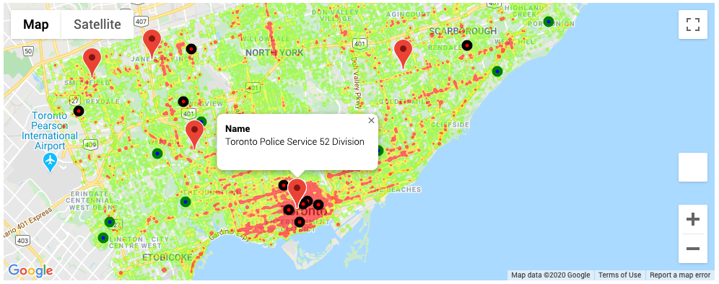
Neighborhood Investigation (aka Question 3)

Slide 13
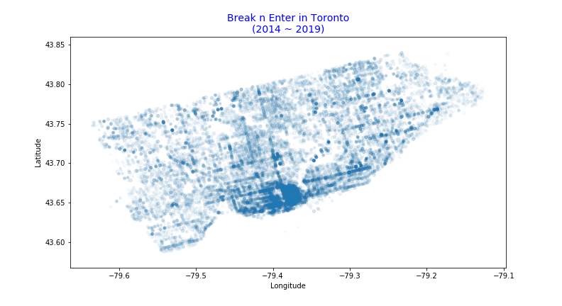
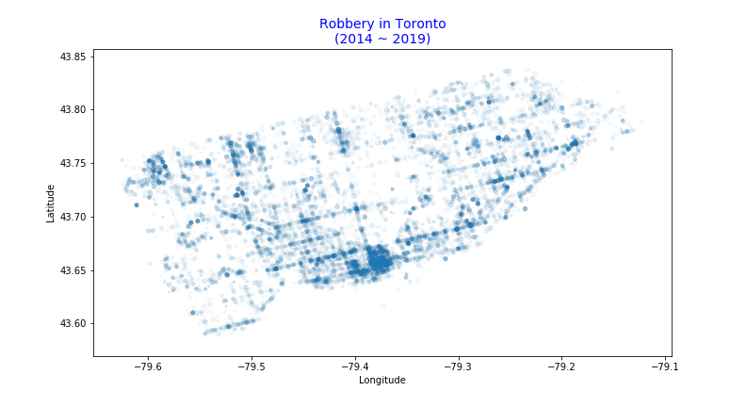
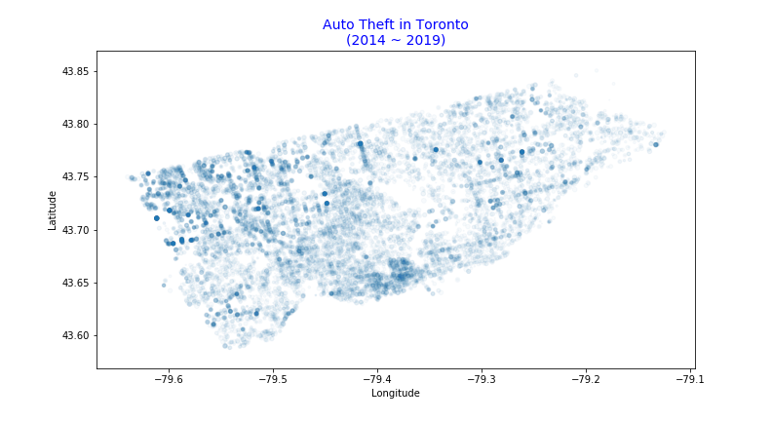
Neighborhood Investigation (aka Question 3)

Slide 14
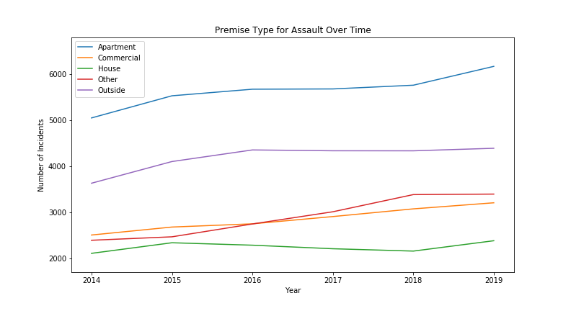
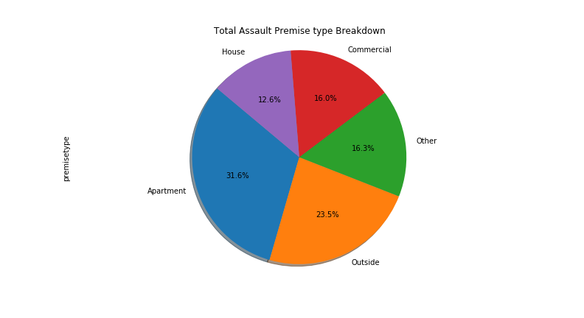
Premise Type Investigation (aka Question 4)

Slide 15
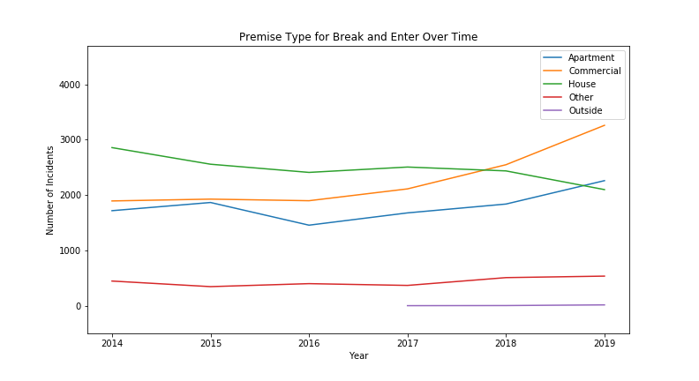
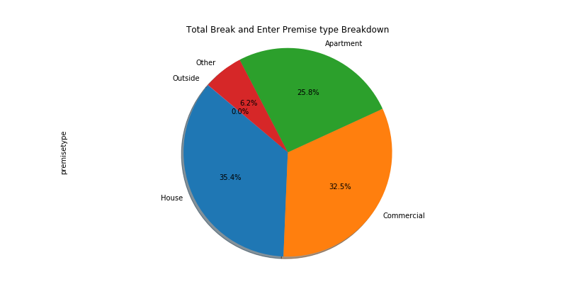
Premise Type Investigation (aka Question 4)

Slide 16
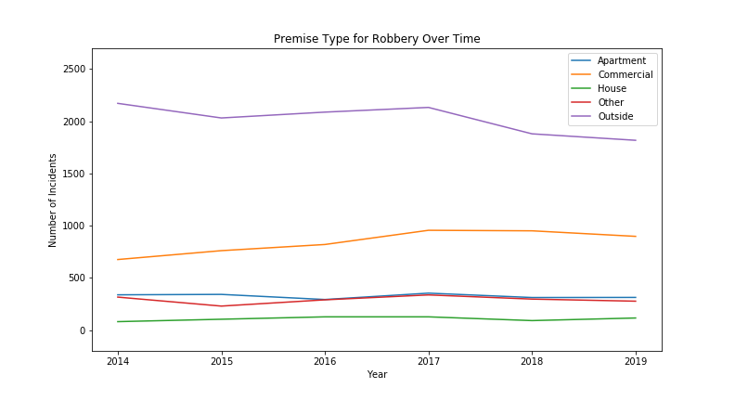
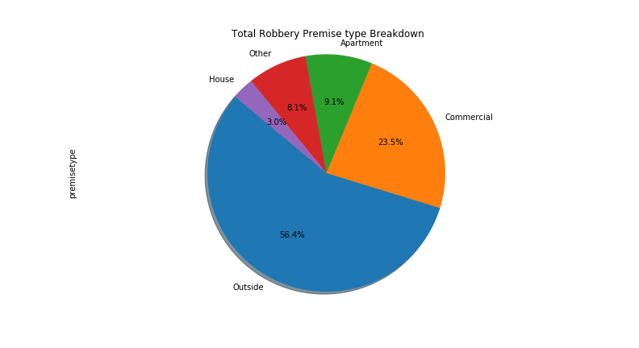
Premise Type Investigation (aka Question 4)

Slide 17
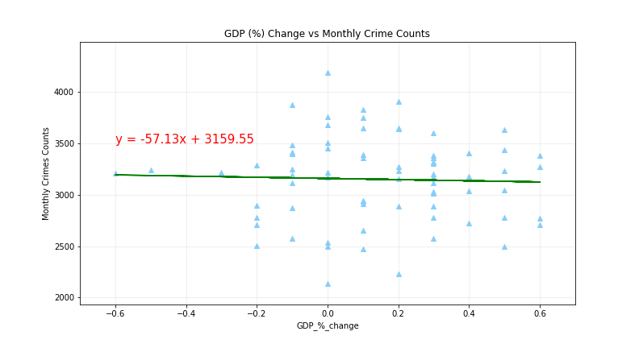
Relationship with GDP Growth Rate (aka Question 5)

Slide 18
Summary
Most interesting part
Challenges
Future investigations
Things that need to improve
Limitations

Slide 19
Q&A

Slide 20
Thank you, next!

